Slide 1

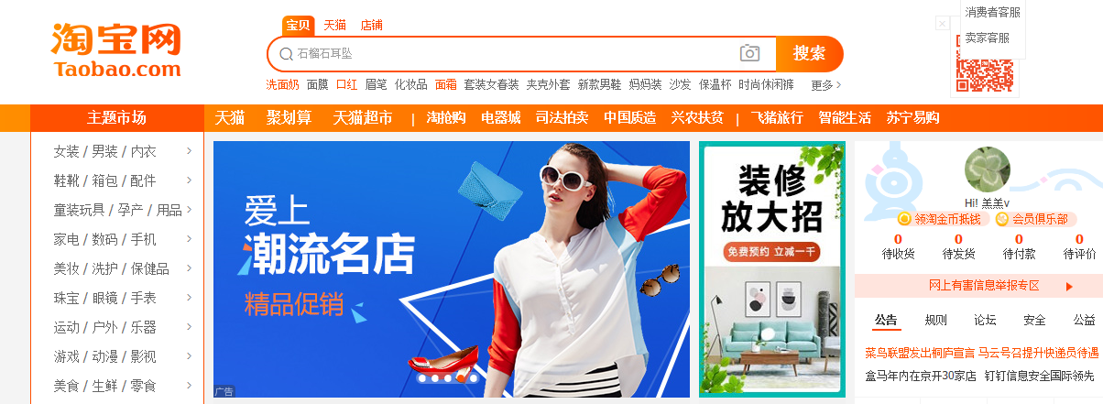
To know Taobao
Link:
https://www.taobao.com/

Slide 2
Agenda
A
Brief introduction
B
Operational process
C
Matters need attention
D
Successful example

Slide 3

A
Brief introduction
Jack Ma
1.Comprehensive C2C online shopping platform（95.1% market share in the end of 2014）.
2.Established in May,2003.
3.Business volume:10,000million RMB（includingT-mall.
com）
4.The big online retail business platform in Asia-Pacific area.
500,000,000 registered members.
60,000,000 permanent website visitors everyday.
The volume of online merchandise is more than 800,000,000.
4.8million pieces of goods were sold per minute on average.
Alibaba group
淘宝网Taobao

Slide 4
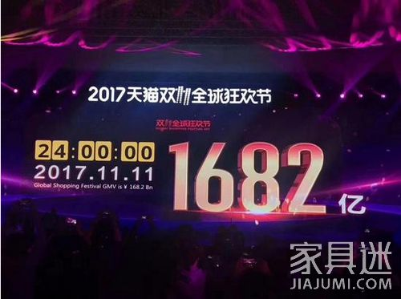
About the income: on the double eleven day, the volume of transaction on Taobao and T-mall online platform is up to 1682 million yuan.
The consumers around the whole world finish the payment via Alipay which has the volume of 14.8million deals, thus increased 41% compared with that in 2016.
And until 24:00 on that day, there were 225 countries and areas totally participated in the T-mall double eleven global shopping carnival in 2017.
The online promotion day of November 11 each year, which is derived from the promotion activities held by Taobao（and T-Mall) on November 11, 2009, when the number of participating businesses and sales promotion are limited, the business is much higher than the expected effect. Double 11 has become an annual event of China's e-commerce industry, and gradually affect the international e-commerce industry.

Slide 5
B
Operational process
Information
flow
Logistic
Financial flow
Upload the products' information
Yunda express
Alipay

Slide 6
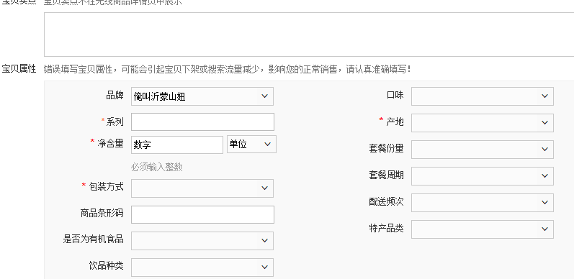
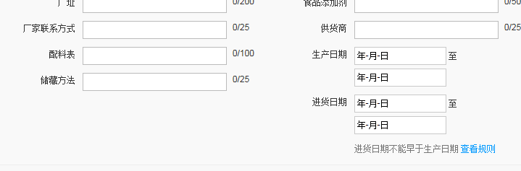
Information flow
Contents & Video & Picture
Context: To describe our products in detail. More clear, more better.

Slide 7
Type1: About the dress or clothes.
The following information about the products were needed: Chinese title, suitable season, clear picture, price, the volum in the warehouse, etc. And other basic info.
Type2: About the skin care products.
Brand name, producing area, functions, suitable type of skin, net content, expiration date, price, the volum in the warehouse, whether it is for special using or cosmetics, etc.
Type3:About food or drinking.
series, net content, producing area, way of packing, whether it is organic food or not, factory's name and adress, their contact information, expiration date, burdening, price and the volum in the warehouse, etc.
Type4
Type5
. . .
. . .
. . .

Slide 8
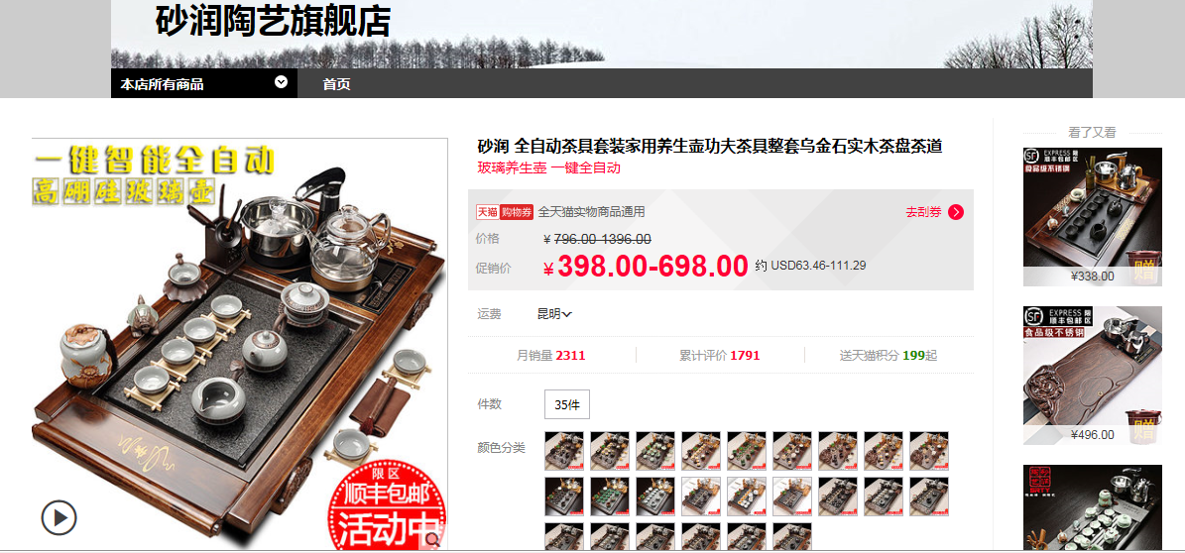
Video: Give an example of using our products. Real model and BGM.
Eg: Ceramics tea set shop

Slide 9
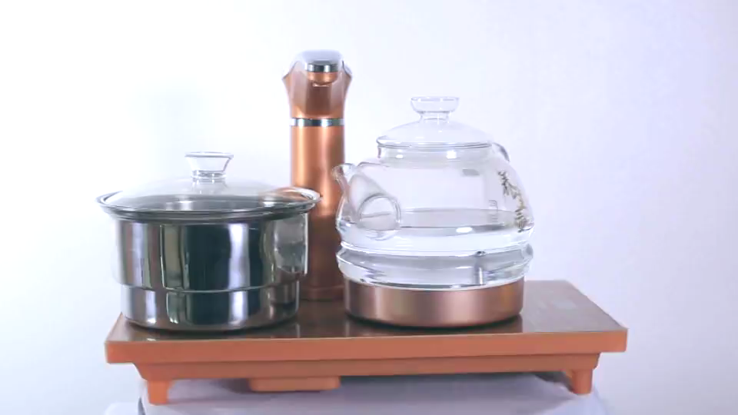
Video: Give an example of using our products. Real model and BGM.

Slide 10
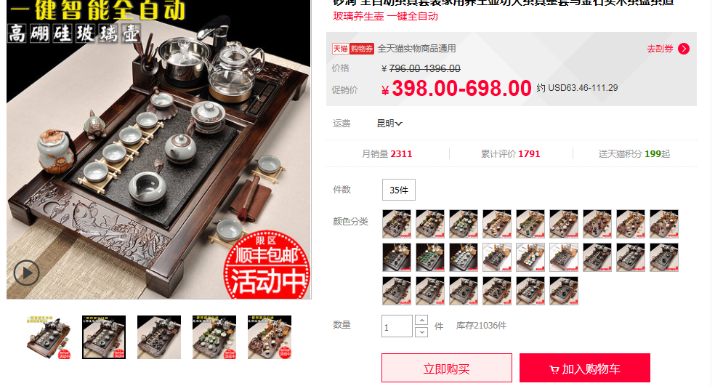
Picture: the number of pictures in maximum is 5.

Slide 11
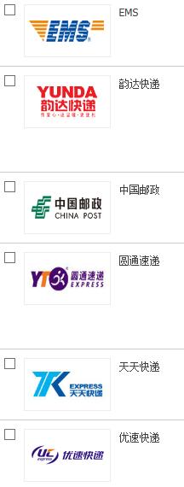
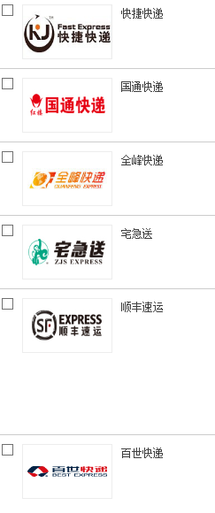
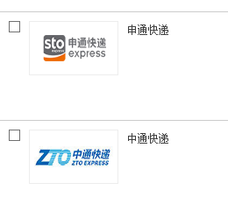
Logistic
14 express companies in China are functioning for Taobao online shop.

Slide 12
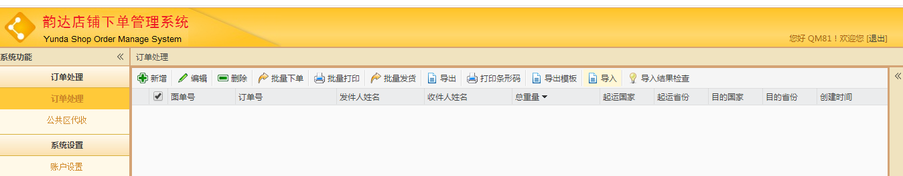
Logistic
Yunda shop order management system
Yunda express Chiangmai China
100BHT/kg
Delivering the goods within 24 hours after the customer finishing the order.
As usually, 20 days on the way.

Slide 13



Financial flow
Seller's taobao account
Customer's taobao account
bind
the third payment platform
bind
Customer's Alipay acccount
step1
bind
step2
bind
Seller's Alipay account
Customer's bank card
bind
Seller's bank card
Security system
This system will work every day.

Slide 14
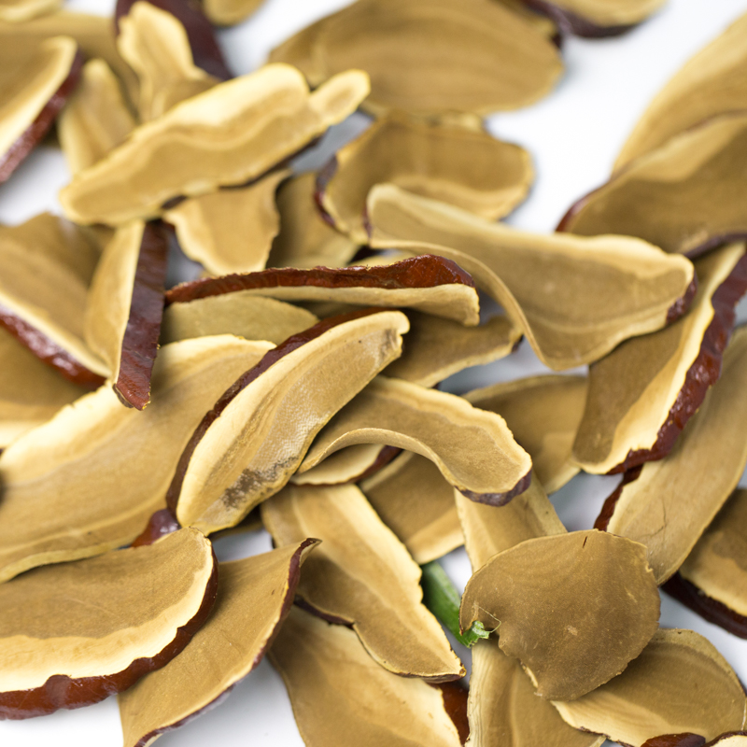
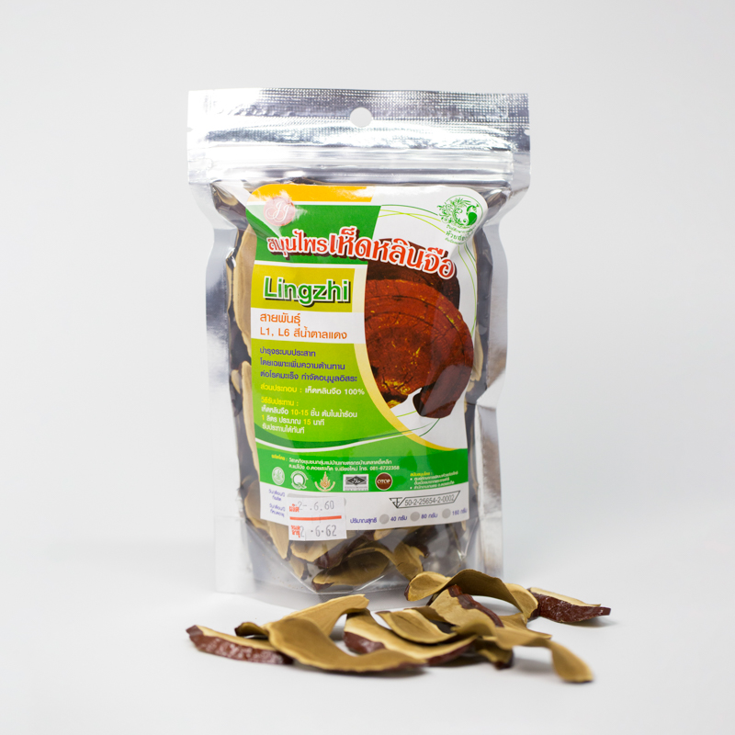

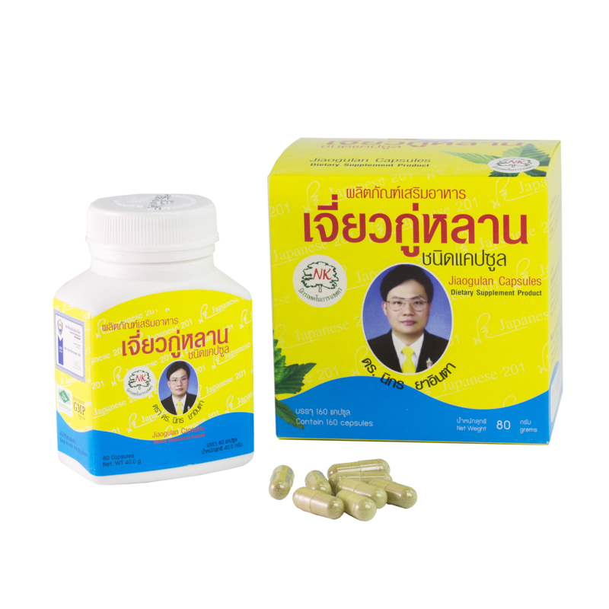

C
Matters need attention
Some products can not be uploaded on the taobao online shop:
Medicine and health care products. for example:

Slide 15
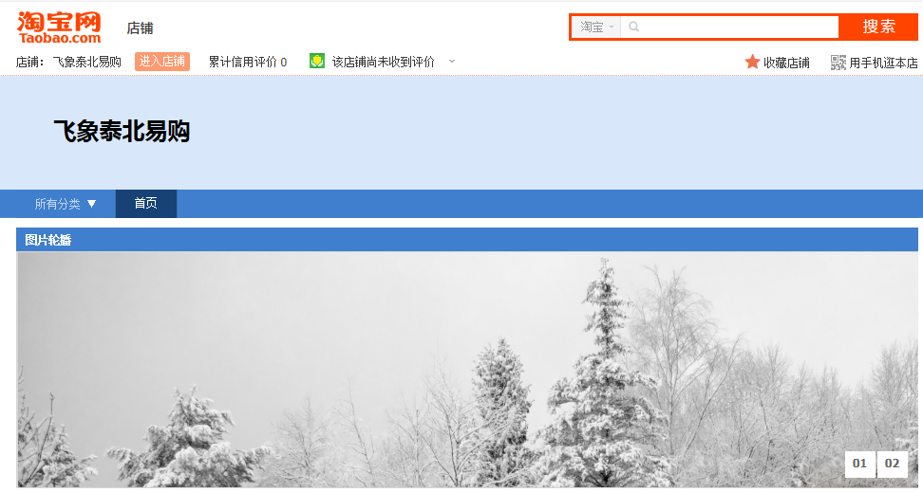
D
Successful example
https://myseller.taobao.com/home.htm?spm=a1z38n.10677092.header.2.9f61565XB8ZFc

Slide 16
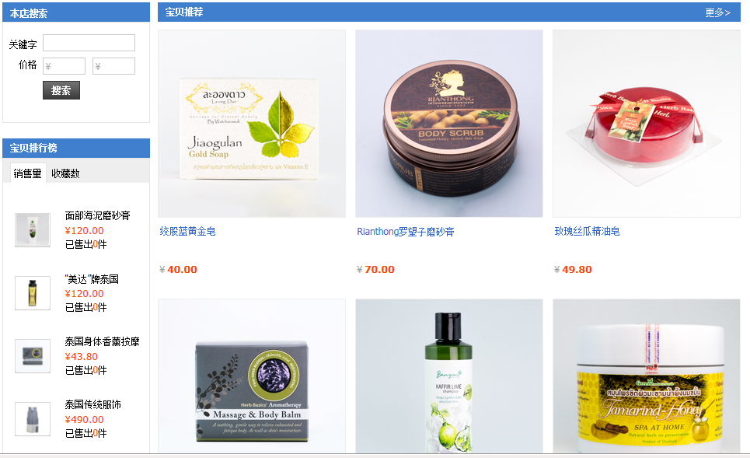

Slide 17
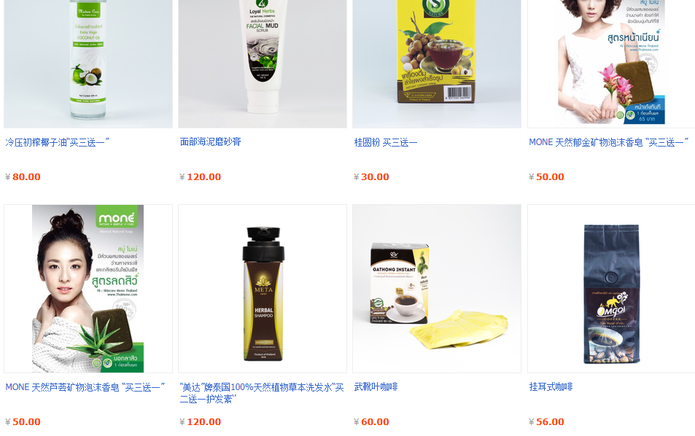

Slide 18
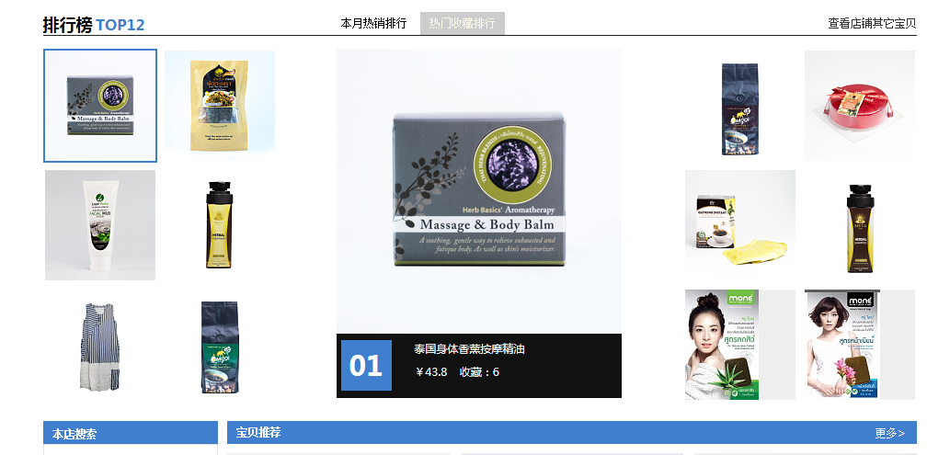

Slide 19
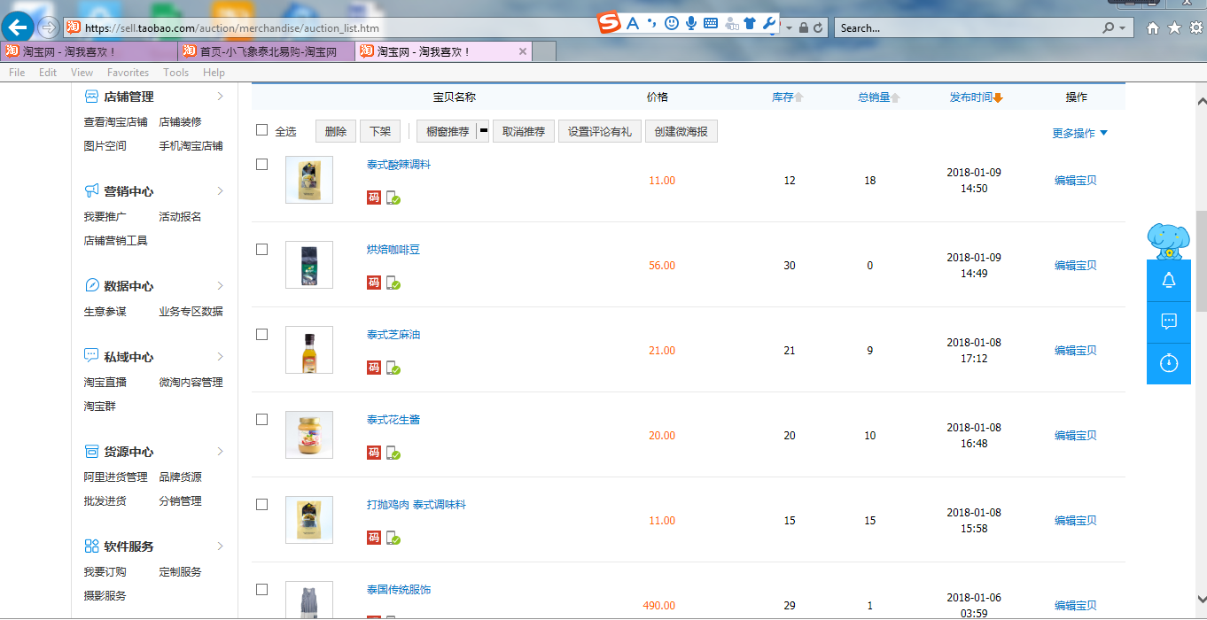

Slide 20
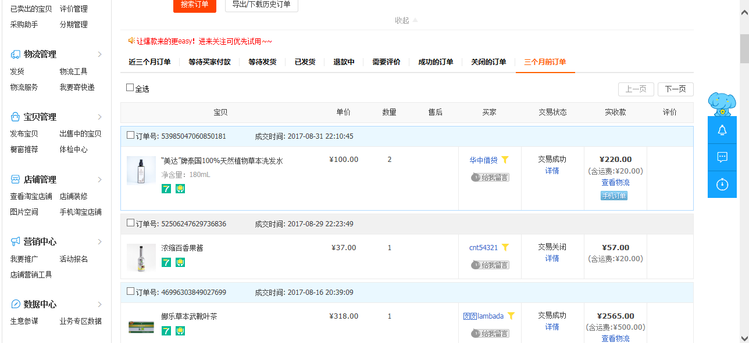

Slide 21
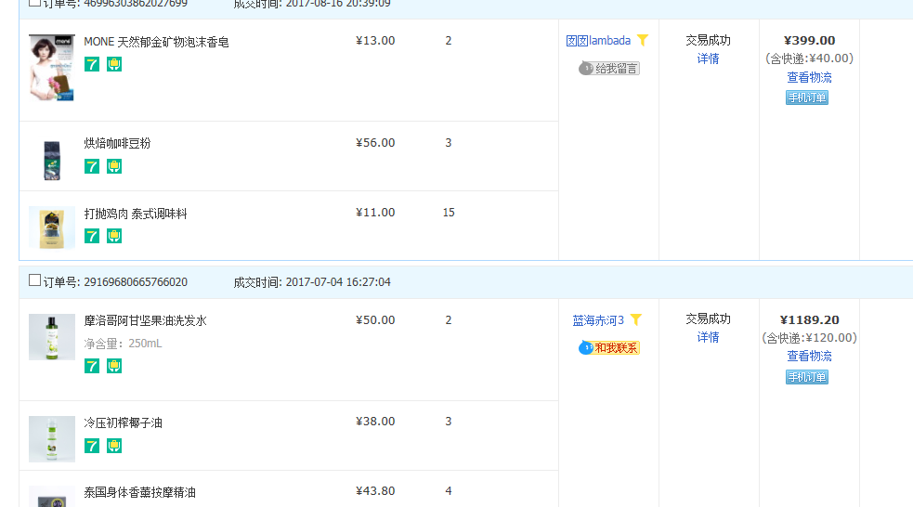
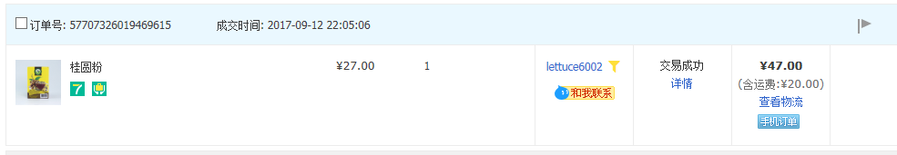

Slide 22
thank you
Dao
Tel: 093-049-6107 E-mail: winonagm@foxmail.com
WeiChat ID: Winona-GM Line ID: dao803
College of Art, media and technology, Chiangmai University

